Slide 1

Modelling & Simulation of type 3 Hydrogen gas cylinders
-by PRANJALI PAGARE
DIAT, PUNE

Slide 2
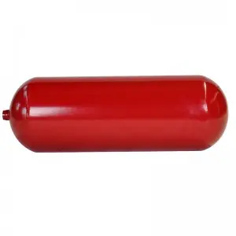
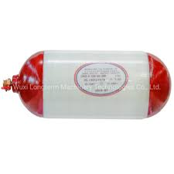
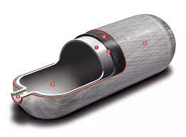
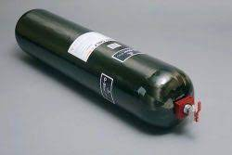
Types of gas cylinders
Type | Picture | Description | Advantage | Disadvantage | Pressure | Application | Cost
Type 1 |  | Type 1 gas cylinders are usually manufactured from steel or aluminum. Suitable for static applications and high-volume industrial use. | Lowest cost | Heaviest cylinder | 200/300 bar to maximum 500 bar | LPG cylinders | Rs. 300-450/litre
Type 2 |  | Gas cylinders are made from aluminum, hoop-wrapped with carbon fiber. | They are significantly lighter than Type 1 cylinders | Significantly heavier than Type 3 carbon composite cylinders. | No pressure limits | Onsite manufacturing | Rs. 450-650/litre
Type 3 |  | Aluminum liner fully overwrapped with carbon composite. So they can offer increased capacity for the same size cylinder. | High strength-weight ratio | Proper handling must be done | Up to 450 bar (can be increased up to 700 bar) | Fuel cell application Drone/UAV | Rs. 670- 1070 / litre
Type 4 |  | Made from carbon composite, with a polymer liner. Most suitable for infrequent use applications where maximum portability is required. | They are the lightest | Most expensive cylinders | 450-700 bar | Portable field testing | Rs. 850-1390/ litre

Slide 3
Why to choose type 3?
It can be reliable at pressures upto 350 bar , cycling tests have been carried upto 700bar.
Seamless aluminum liner:
The aluminum liner can conduct heat away from the internal storage spaces.
Impact tolerance:
The liner mitigates the risk of composite flexing and subsequent breakage. Type 3 is known to be less resistant to damage than type 4.
Heat tolerance:
Type 3 have greater heat resistance. This enables to achieve greater fill as compared to type 4 cylinder.
Better filling efficiency:
The aluminum liner has high thermal conductivity helping to achieve a more complete fill even during fast fill operations.
Burst safety:
Aluminum liner in type 3 have high resistance to corrosion despite the presence of aggressive components in natural gas. They are built with a burst safety factor to ensure maximum safety of vehicles.

Slide 4
Hydrogen gas cylinders
Hydrogen gas cylinder needs to have highest strength-weight ratio.
The fuel cell vehicle industry requires hydrogen gas to be pressurized from 350-700 bar.
Type 3 and type 4 vessels are therefore employed for such vehicles.
For transport we use refillable portable hydrogen cylinders per transport vehicle.
In composite cylinders, metal liner serves as the hydrogen permeation barrier.
TYPE III

Slide 5
construction
Thickness of the liner:
Minimum winding angle calculations: 15.2165⁰
Determination of minimum layer thickness:
Theoretical model angles:(90/15.2165/….)_{s}

Slide 6
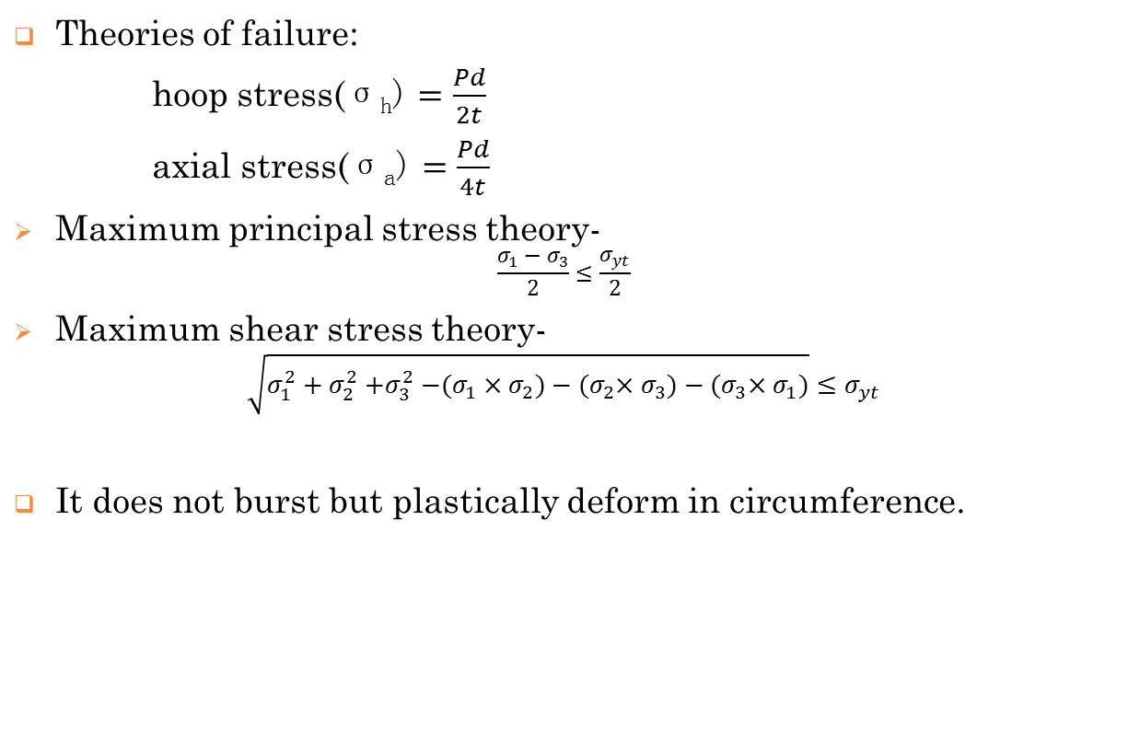
Theories of failure:
hoop stress$\text{(}\text{σ}\text{h}\text{)}=\frac{Pd}{2t}$
axial stress$\text{(}\text{σ}\text{a}\text{)}=\frac{Pd}{4t}$
Maximum principal stress theory-
$$\frac{σ_{1}−σ_{3}}{2}≤\frac{σ_{yt}}{2}$$
Maximum shear stress theory-
$$\sqrt{σ_{1}^{2}+σ_{2}^{2}{+σ}_{3}^{2}−(σ_{1}{×σ}_{2})−{(σ}_{2}{×σ}_{3})−{(σ}_{3}×σ_{1})}≤σ_{yt}$$
It does not burst but plastically deform in circumference.

Slide 7
geometry
Working pressure: 350bars
Bursting pressure: 787.5 bars
Test pressure : 525 bars
Volume : 183 ± 2.5% liters
Weight of the cylinder: 87±4.5kg
Working temperature: -40 to 85⁰C
Inner diameter: 366 (+0.5 and -0)mm
Outer diameter: 381±0.5mm
Overall diameter(liner +cylinder): 415±4mm
Length: 1910±8mm
Lifespan: 15-20years
The cylinder is dual ported

Slide 8
liner
What is a liner?
The liner provides a barrier between the fluid and the composite, preventing the leaks (which can occur through micro cracks which do not cause structural failure) and chemical degradation of the structure.
Generally, aluminum or steel liners are used.
Properties of Al and steel liner:
Aluminum liner | Steel liner
Aluminum liner offers better corrosion resistance | Steel liner does not provide corrosion resistance
Aluminum is malleable and has smooth fabrication | Steel is extremely durable and resilient
It is prone to dents and scratches than steel | Steel is less likely to bend or wrap
Aluminum vessel can be built 2/3rd the weight of a comparable steel boat | Steel’s weight/density is 2.5 times that of aluminum
Aluminum is costly as compared to steel | Steel is cheaper than aluminum

Slide 9
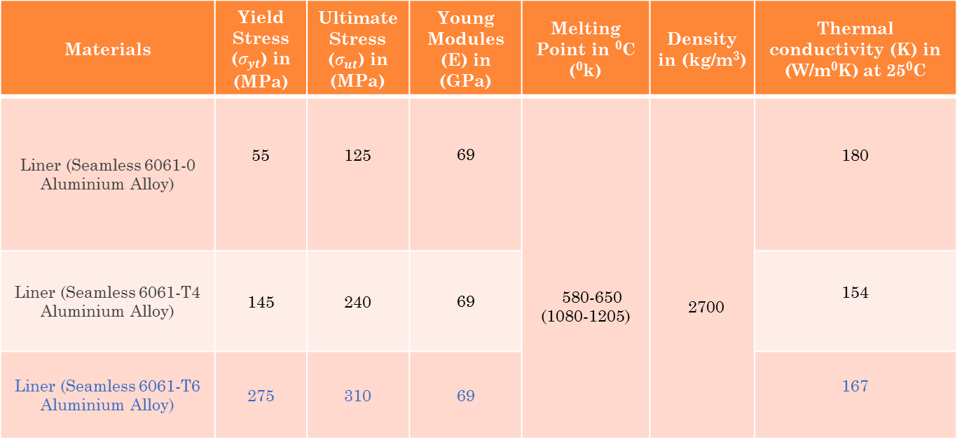
Properties of different grades of Seamless 6061 Aluminium alloy
Materials | Yield Stress ($σ_{yt}$) in (MPa) | Ultimate Stress ($σ_{ut}$) in (MPa) | Young Modules (E) in (GPa) | Melting Point in ⁰C (⁰k) | Density in (kg/m³) | Thermal conductivity (K) in (W/m⁰K) at 25⁰C
Liner (Seamless 6061-0 Aluminium Alloy) | 55 | 125 | 69 | 580-650 (1080-1205) | 2700 | 180
Liner (Seamless 6061-T4 Aluminium Alloy) | 145 | 240 | 69 |  |  | 154
Liner (Seamless 6061-T6 Aluminium Alloy) | 275 | 310 | 69 |  |  | 167
Credit – ASM Material Data Sheet & www.material- properties.org

Slide 10
Factors for choosing right cylinder
Cost
Weight
Pressure/ capacity
Durability
Lifespan

Slide 11
Material selection & fabrication
Composite materials:
These consists of two or more components
High strength- weight ratio
Controlled anisotropy

Slide 12
Types of Fiber
Glass fiber
Boron fiber
Ceramic fiber
Metal fiber
Aramid fiber
Natural fiber
Carbon fiber

Slide 13
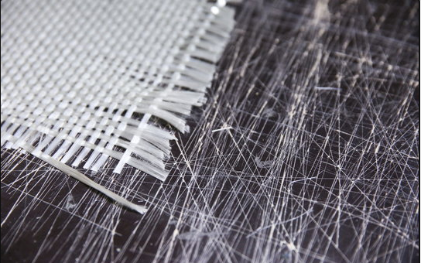
1. Glass fiber
Textile-grade glass fibers are made from silica (SiO₂) sand, which melts at 1720°C/3128°F. SiO₂ is also the basic element in quartz, a naturally occurring rock.
Glass fiber reinforced polymer also known as glass fiber reinforced plastic is a composite material weaving fiber E-glass and polyester material together.
Only weighing a quarter of the weight of steel.
Advantages of Glass Fiber –
Corrosion resistant
Good structural strength
Superior strength-to-weight ratio
High heat distortion temperature
Cost Rs. 55-220/kg
Fig. Glass fiber

Slide 14
Types of Glass Fiber
Fiber | Density (kg/m³) | Yield Stress (GPa) | Young Modules (GPa) | Elongation (%) | Coefficient of thermal Expansion (10⁻⁷/ °C) | Poisson's Ratio | Cost
E-Glass | 2580 | 3.445 | 72.3 | 4.8 | 54 | 0.2 | Rs 71/kg
C-Glass | 2520 | 3.310 | 68.9 | 4.8 | 63 | 0.276 | Rs 60/kg
S2-Glass | 2460 | 4.890 | 86.9 | 5.7 | 16 | 0.22
A-Glass | 2440 | 3.310 | 68.9 | 4.8 | 73 | 0.21 | Rs 55/kg
D-Glass | 2110-2140 | 2.415 | 51.7 | 4.6 | 25 | 0.23 | Rs 218-232/kg
R-Glass | 2540 | 4.135 | 85.5 | 4.8 | 33 | 0.21
ECR-Glass | 2720 | 3.445 | 80.3 | 4.8 | 59 | 0.21 | Rs 57/kg
AR-Glass | 2700 | 3.241 | 73.1 | 4.4 | 65 | 0.21 | Rs 324/kg
Notes:
Sameer Bara

Slide 15
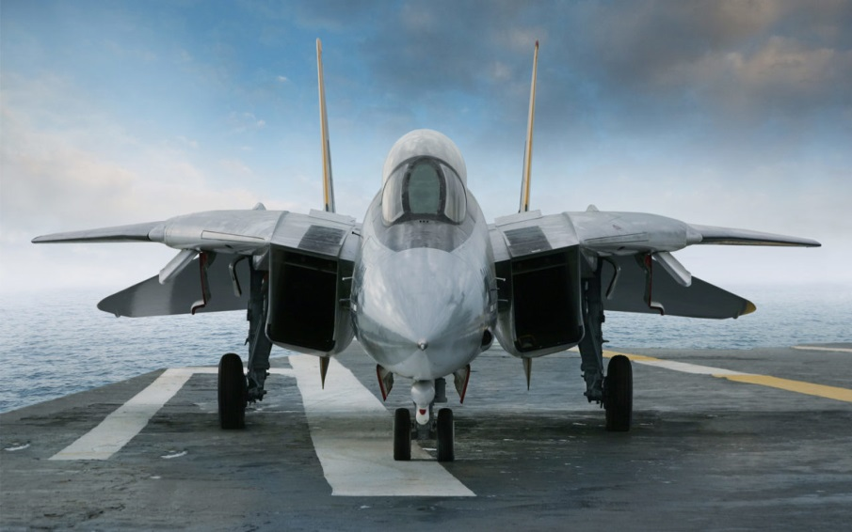
2.Boron fibers
No other composite material has higher compressive strength properties than Boron fiber & fiber composites.
Boron fiber use results in high-strength, lightweight materials that are used chiefly for advanced aerospace structures as a component of composite materials.
Adding Boron fiber to composites with standard & intermediate modulus fibers will increase the tensile & compression modulus.
No galvanic corrosion with boron fiber.
Disadvantage:
Due to amalgam characteristics of boron fiber,
complex internal stresses and defects such as
voids and structural discontinuities indicate the
presence of a core and deposition process.
High cost compared to other fibers
Cost: Rs. 400-1000/kg
F-14 Tomcat fighter aircraft

Slide 16
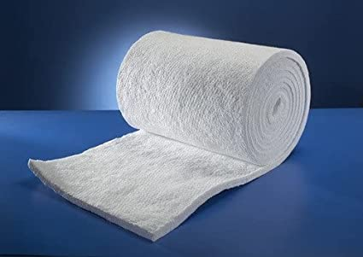
3. Ceramic fiber
Ceramic Fiber is a man-made synthetic fiber produced from small-dimension filament composed of high purity aluminosilicate materials. It also known as ‘Ceramic Wool’ or “refractory material”, cause it has a heat-resistant property, white and odourless substance.
Uses:
High temperature insulation seals and gaskets
Thermal shield
Fire barrier
Fire Retardant Fabric
Electrical insulation
Composite reinforcement
Advantages and Benefits of Ceramic Fiber:
Low elongation rate
Low retraction rate
Excellent dielectric strength
Excellent chemical resistance
Excellent resistance to thermal shock
Low thermal conductivity
Low porosity, etc.
Disadvantage is that it is neither wear resistant nor collision resistant, cannot resist erosion of high-speed airflow, and cannot resist slag erosion.
Cost: Rs. 130 - 205/kg

Slide 17
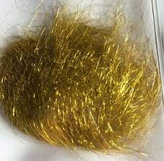
4. Metal fiber
Metallic fibers are manufactured fibers composed of metal, metallic alloys, plastic-coated metal, metal-coated plastic, or a core completely covered by metal.
Having their origin in textile and clothing applications, gold and silver fibers have been used since ancient times as yarns for fabric decoration. More recently, aluminium yarns, aluminized plastic yarns, and aluminized nylon yarns have replaced gold and silver.
Metal fibers have a low electrical resistance. This makes them suitable for any application that requires electrical conductivity.
Their excellent thermal resistance makes them withstand extreme temperatures. Corrosion resistance is achieved through the use of high-quality alloys in stainless steels or other metals. Other advantageous mechanical properties of metal fibers include high failure strain, ductility, shock resistance, fire resistance and sound insulation
Properties:
Lustrous and will tarnish
Bright and appealing
Often Heavy (e.g. silver and gold)
High-Maintenance (aftercare can be problematic)
The yarns are flexibility and some extensibility
Good strength and hence can be used as warp or weft yarn
Good chemical and biological resistance
Disadvantage:
Their weight and the tendency to react each other through alloying mechanisms are major disadvantage.
Costly
Cost: Rs. 52-200/kg

Slide 18
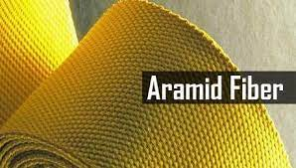
5. Aramid fiber
Aramid fiber was the first organic fiber used as reinforcement in advanced composites with high enough tensile modulus and strength. They have much better mechanical properties than steel and glass fibers on an equal weight basis. Aramid fibers are inherently heat and flame-resistant, which maintain their properties at high temperatures.
Advantages:
High strength
Resistance to absorption
Resistance to organic solvent
Good chemical resistance
No conductivity
No melting point low flammability
Excellent heat and cut resistance
Sensitive to acids and ultraviolet radiation
Disadvantages: The fibers absorb moisture, so aramid composites are more sensitive to the environment than glass or graphite composites. Compressive properties are relatively poor too. Aramid fibers are difficult to cut and to grind without special equipment. Suffer some corrosion and are degraded by UV light.
Kevlar (ARAMID) is much stiffer than Glass but Not as stiff as Carbon Fiber.
Cost: 2500 – 4000 Rs./Kg

Slide 19
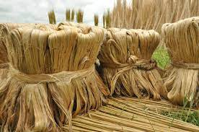
6. Natural fiber
Natural fibers are fibers that are produced by geological processes, or from the bodies of plants or animals. They can be used as a component of composite materials, where the orientation of fibers impacts the properties.
The main characteristics of natural fibers are low energy consumption, low density, non-abrasive nature, low cost, renewability, biodegradability, easy availability, and worldwide abundance.
Plant fibers:
Cotton: It's almost pure cellulose, with softness and breathability that have made it the world's most popular natural fiber. It absorbs moisture readily, high tensile strength. Cotton is the world's most widely used natural fiber.
Jute: Jute is long, soft and shiny, It is one of nature's strongest vegetable fibers. Jute has high insulating and anti-static properties, moderate moisture regain and low thermal conductivity.
Coir: Coir has one of the highest concentrations of lignin,
making it stronger but less flexible than cotton and
unsuitable for dyeing. The tensile strength of coir is low,
but it has good resistance to microbial action and salt water
damage.

Slide 20
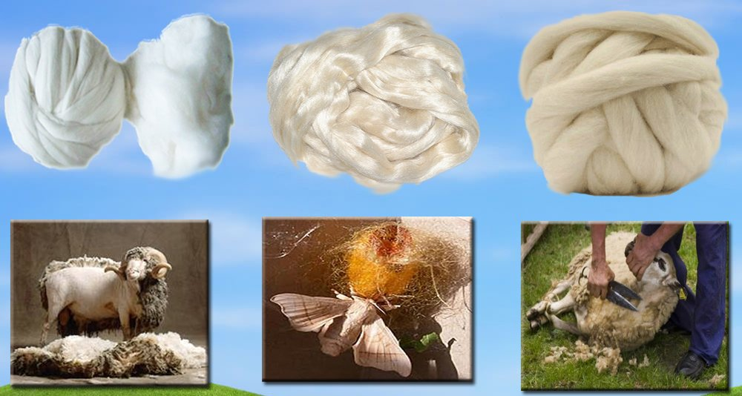
Animal fibers:
Cashmere: It has natural crimp, allowing it to be spun into fine, lightweight fabrics. Cashmere has small air spaces between the fibers, which makes it warm without weight, while thin cuticle cells on the fiber surface make it smooth and lustrous. Its luxurious, rare and expensive.
Silk: It's filament is a continuous thread of great tensile strength . It has good absorbency, low conductivity and dyes easily.
Wool: It has natural crimpiness and scale patterns that make it easy to spin. Fabrics made from wool have greater bulk than other textiles, provide better insulation and are resilient, elastic and durable.
Camel: Baby camel hair, which can
measure as little as 16 microns, is
the softest and most prized. Owing
to its quality and scarcity, camelhair
is used in luxury textiles.
Cost - Rs. 85 - 175/Kg .

Slide 21
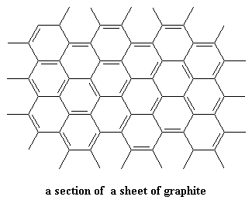
7. Carbon Fibers
Carbon fiber is composed of carbon atoms bonded together to form a long chain.
The properties of a carbon fiber part are close to that of steel and the weight is close to that of plastic.
Carbon fiber is a form of graphite in which the sheets are long and thin

Slide 22
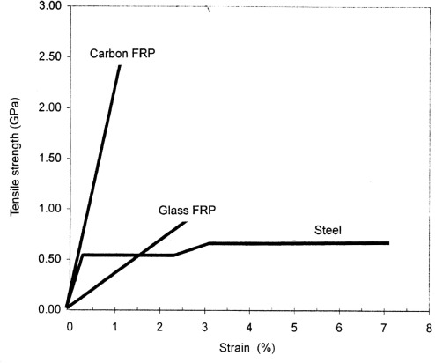
properties
High Strength to Weight Ratio
Rigid
Corrosion Resistant and Chemically
Stable
Electrically Conductive, Fatigue
Resistance is good
Has good Tensile Strength
Fire Resistance/Non Flammable
Thermal Conductivity of Carbon Fiber
Special types of Carbon Fiber have been specifically designed for high or low thermal conductivity.
Low Coefficient of Thermal Expansion
Suitable for applications where small movements can be critical. Telescope and other optical machinery is one such application.

Slide 23
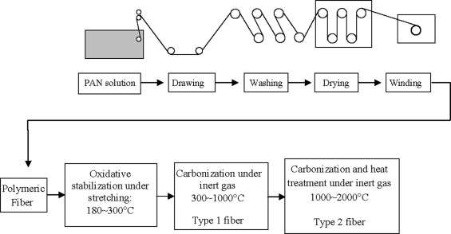
Non Poisonous, Biologically Inert, X-Ray Permeable
Carbon Fiber is Relatively Expensive
The low maintenance requirement of carbon fiber is a further advantage.
Carbon Fibers are brittle
Manufacturing Process of Carbon Fibers

Slide 24
Properties of different Carbon Fiber
Classification | Carbon Fiber | Young Modules [GPa] | Tensile Strength [GPa] | Electricalresistivity [μΩ·m] | Thermal conductivity [W/m·K] | Common Application | Cost
PAN-based carbon fiber | T300 | 230 | 3.5 | 18.0 | 14 | Various including weaving and prepreg, especially for drapability | Rs.1717.05 /kg
 | T650 | 255 | 4.3 | 15.2 | 15 | Various including prepreg unidirectional tape
 | T800 | 294 | 5.9 | 14 | 16 | Weaving and prepreg
 | M35 J | 343 | 4.7 | 11 | 45 | Weaving and specialty prepreg
Pitch-based carbon fiber | P25 | 160 | 1.56 | 12.1 | 36 |  | Rs. 19,970.51-60,319.59 /ton
 | P30 | 207 | 1.4 | 10.2 | 62
 | P55 | 220 | 0.9 | 9.4 | 74
 | P100 | 470 | 1.0 | 4.6 | 321
 | K1100 | 565 | 3.1 | 1.1–1.3 | 900–1000
Source : Book “Handbook of Advanced Ceramics Materials, Applications, Processing, and Properties“ • Second Edition • 2013 Chapter - 2.1
Notes:
Sameer Bara

Slide 25
Grades of carbon fibers
Types | Specifications | Major Usage
Filament | A yarn constituted of numerous number of fiber: twisted, untwisted, twisted-and-untwisted | Resin reinforcement material for CFRP, CFRTP or C/C composites, having such usage as Aircraft/Aerospace equipment, sporting goods and industrial equipment parts
Tow | An untwisted bundle of yarn constituted of extremely numerous number of fiber | Ditto
Staple Yarn | A yarn made of spinning of staples | Heat Insulator, Anti-friction material, C/C composite parts
Woven fabric | A woven sheet made of filament or staple yarn | Resin reinforcement material for CFRP, CFRTP or C/C composites, having such usage as Aircraft/Aerospace equipment, sporting goods and industrial equipment parts
Prepreg | An intermediate material in a form of half-hardened sheets made of Carbon Fibers impregnated with thermo-setting resin, qualities of which being stable and sustained long enough and therefore easily applicable for automatic sheet-layering | Aircraft/Aerospace equipment, sporting goods and industrial equipment parts needing lightness in weight and high performances
Braid | A braided yarn made of filament or tow | Resin reinforcement material particularly suitable for reinforcement of tubular products
Chopped fiber | A chopped fiber made of sized or non-sized fiber | Compounded into plastics/resins or Portland cement to improve mechanical performances, abrasion characteristic, electric conductivity and heat resistance
Milled | Powder made by milling fiber in a ball-mill etc. | Compounded into plastics/resins or rubber to improve mechanical performances, abrasion characteristic, electric conductivity and heat resistance
Felt.Mat | A felt or mat made by layering up of staple by carding etc. then needle-punched or strengthened by organic binders | Heat insulator, base material for molded heat insulator, protective layer for heat resistance and base material for corrosion-resisting filter
Paper | A paper made from staple by dry or wet paper-making | Anti-electrostatics sheets, electrodes, speaker-cone and heating plate
Compounds | A material for injection moulding etc. made of mixture of thermo-plastics or thermo-setting resins added by various additives and chopped fiber and then being compounded | Housing etc. of OA equipment taking advantages of electric conductivity, rigidity and lightness in weight

Slide 26
Materials other than carbon fibers
Carbon nanotubes
Borophene

Slide 27
Matrix/Resin
Matrix binds the reinforcement fibers in a filament wound composite structure and spreads the load together.
Two relevant characteristics to be used effectively:
An acceptable viscosity to wet the reinforcement before initiating the cure reaction.
A sufficiently long pot life to allow all the reinforcement layers to be applied with no premature gelling of the resin.
TYPES OF RESIN:
Thermoplastic
Thermoset

Slide 28
a . Thermoplastic Resins
A thermoplastic is a type of plastic made up of polymer resins that is solid at room temperature but becomes plastic and soft upon heating.
It is Hard, brittle, opaque, good electrical and heat resistance, resistant to deformation under load, low cost, resistant to most acids.
Thermoplastics are easily recycled and do not show any chemical property changes when heated or cooled multiple times, which makes them easy to recycle.
Eg. Polypropylene, polyphenylene sulfone, polyamide, polyether ether ketone, phenolic, silicones, polyurethanes, epoxies, etc.
 | Properties | Magnitude
01. | Density | 923- 2170 kg/m³
02 | Water Absorption | -
03. | Viscosity | 500–5000 N-s/m²
04. | Tensile Strength, Yield | 10.8-98.8MPa
05. | Tensile Strength, Ultimate | 11-110MPa
06. | Modulus of Elasticity | -
07. | Poisson Ratio | 0.33-0.39
08. | Thermal Conductivity | 0.11-0.35 W/m-K
09. | Melting Point | 110-340 °C
10. | Elongation at break | 4.1-190 %
11. | Cost | Rs.150-165 /Kg

Slide 29
B. Thermoset Resins
A thermosetting resin is generally a liquid material at room temperature which hardens irreversibly upon heating or chemical addition.
It is high dimensional stability, high-temperature resistance, and good resistance to solvents.
Thermoplastics are melt under heat after curing while thermoset resin retain their form and stay solid under heat once cured.
Thermosetting resins are popular because of uncured, at room temperature, they are in a liquid state. This allows for convenient impregnation of reinforcing fibers such as fiberglass, carbon fiber, Kevlar.
Sr. No. | Properties | Magnitude
01. | Density | 1200 - 1250 kg/m³
02. | Viscosity | -
03. | Tensile Strength, Yield | 51 Mpa
04. | Thermal Conductivity | 0.17–0.21 W/m-K
05. | Maximum Working Temperature | 120 - 300 °C
06. | Cost | Rs. 140 - 900/Kg
Notes:
Kevlar is a manufactured plastic, and it's made of a chemical compound called poly-para-phenylene terephthalamide. This chemical is made from creating a chemical reaction between an acid and a chemical solution containing nitrogen and hydrogen.

Slide 30
1. Polypropylene
Polypropylene (PP) resins are thermoplastic polymers, they may be formed with heat and re-melted without losing their intrinsic characteristics.
Polypropylene resins are usually opaque, low-density polymers with excellent thermoforming and injection molding characteristics. Compared with other polymers, the material has a relatively narrow temperature range, becoming brittle below -20°C and unusable in temperatures beyond 120°C.
Benefits:
Chemical Resistance
Elasticity and Toughness
Fatigue Resistance
Insulation
Transmissivity
Sr. No. | Properties | Magnitude
01. | Density | 33-35 kg/m³
02 | Water Absorption | -
03. | Viscosity | 9740 N-s/m²
04. | Tensile Strength, Yield | 12-43 MPa
05. | Tensile Strength, Ultimate | MPa
06. | Modulus of Elasticity | 1600 MPa
07. | Poisson Ratio | 0.43
08. | Thermal Conductivity | 0.40 W/m-K
09. | Cost | Rs. 65-75/Kg

Slide 31
2. Polystyrene
Sr. No. | Properties | Magnitude
01. | Density | 1050 kg/m³
02 | Water Absorption | -
03. | Viscosity | -
04. | Tensile Strength, Yield | 16 MPa
05. | Tensile Strength, Ultimate | -
06. | Modulus of Elasticity | 1500 MPa
07. | Poisson Ratio | 0.34
08. | Thermal Conductivity | 0.17 W/m-K
09. | Cost | Rs. 85-90/Kg
Polystyrene resin is a thermoplastic polymer produced from styrene, a petroleum derived liquid hydrocarbon.
The resin possesses low softening temperatures, good wear characteristics, a high refractive index, and excellent electrical insulation properties.
Polystyrene resin is used in a wide range of manufacturing processes such as injection molding, sheet and film extrusion, and expanded foam extrusion.
Disadvantage:
The first is the fire risk involved. Polystyrene products, are easily ignited, burn with a very hot flame, and exude large amounts of toxic fumes and soot.
Polystyrene products do not biodegrade for several centuries; film and foam items, among others, float and are easily blown around by the wind.

Slide 32
3. Polyester
The primary advantage of polyester resin centers on its excellent mechanical and chemical stability, as well as low cost. It can be combined with glass fiber to create a composite structure – fiberglass.
This is an incredibly strong, lightweight and durable material with proven waterproofing, abrasion resistance and protective features.
Polyester resin is the cheapest kind of resin and the worst one to use for carbon fiber lay-up.
The resin is inflexible and will spider-crack at the mere thought of bending. Spider cracks fracture from the point of damage and are very difficult to fix.
It will also shrink over time and alter the shape of the final product. It is also not UV resistant and will turn yellow over time.
Sr. No. | Properties | Magnitude
01. | Density | 1090 kg/m³
02 | Water Absorption | -
03. | Viscosity | 0.25-0.35 N-s/m²
04. | Tensile Strength, Yield | 40 MPa
05. | Tensile Strength, Ultimate | -
06. | Modulus of Elasticity | 3300MPa
07. | Poisson Ratio | 0.38
08. | Thermal Conductivity | 0.227-0.313 W/mK
09. | Cost | Rs. 120 –149/Kg

Slide 33
4. Alkyd Resins
Sr. No. | Properties | Magnitude
01. | Density | 914.5 – 950.2 kg/m³
02 | Water Absorption | -
03. | Viscosity | 4.77-6.48 N-s/m²
04. | Tensile Strength, Yield | -
05. | Tensile Strength, Ultimate | -
06. | Modulus of Elasticity | 2.5-9MPa
07. | Maximum Working Temperature | 80 -200 °C
08. | Cure Time | 20 to 30 min
09. | Cost | Rs. 78-150/Kg
Alkyd resins are oil-based polyester consist of dibasic acid, polyols, and fatty acid, which belong to thermosetting or thermoplastic polymer.
The fatty acid content and glycerol of alkyd resins can be derived from either animal or vegetable oils, which are biologically renewable.
It is anticorrosive, low cost, environmental friendliness, biocompatibility, sustainability, high adhesion to substrate, excellent film-forming performance and good mechanical properties.
Alkyd resins are used in paints, varnishes and in moulds for casting.
Alkyd resins are not use with carbon fiber reinforcement.

Slide 34
5. Polyimide
Polyimide resins are soluble thermoplastic or thermoset polyimides used for high-temperature adhesives and composites. They are a class of thermally stable resins that have proven to be technically important due to their strength at high temperatures and their high resistance to oxidative degradation.
Thermoset polymer matrix polyimides exhibit very low creep and high tensile strength.
Strengths:
High mechanical performance
Superior temperature adaptability
Excellent tensile and compressive strength
Outstanding chemical resistance
Transparency in many microwave applications
Radiation resistance
Superior bearing and wear properties
limitations:
Has high manufacturing cost
Sensitive to alkali and acid attacks can be used as matrix with carbon fibers
Sr. No. | Properties | Magnitude
01. | Density | 1310 kg/m³
02 | Water Absorption | -
03. | Viscosity | 1-3 N-s/m²
04. | Tensile Strength, Yield | 3.9 MPa
05. | Tensile Strength, Ultimate | 231MPa
06. | Modulus of Elasticity | 38.6 MPa
07. | Poisson Ratio | 0.25-0.41
08. | Thermal Conductivity | 95.40 W/mK
09. | Toxicity | Highly flammable liquid and vapor. Causes skin and eye irritation. Toxic in contact with skin.
10. | Cost | Rs. 110-175/Kg

Slide 35
6. Polycarbonate
Polycarbonate resin is extremely lightweight with glass-like transparency and toughness – even at high or low temperature extremes
Polycarbonate (PC) has high impact strength compared to other plastics, thus it is expected to be used as the matrix in a CFRTP (carbon fiber reinforced thermoplastic)
However, large-scale equipment is needed and a higher press load is required in order to impregnate PC into continuous fibers.
Provided are a polycarbonate resin composition having excellent flame retardancy and ability to impregnate continuous fiber reinforcement materials
Sr. No. | Properties | Magnitude
01. | Density | 1200 kg/m³
02 | Water Absorption | -
03. | Viscosity | 11.76804 Ns/m²
04. | Tensile Strength, Yield | 60 MPa
05. | Tensile Strength, Ultimate | 70 MPa
06. | Modulus of Elasticity | 2300 MPa
07. | Poisson Ratio | 0.3182
08. | Thermal Conductivity | 20W/m-K
09. | Cost | Rs. 140-155/Kg

Slide 36
7.Phenolic
Have the advantage of being lightweight, strong, tough, yet heat resistant, and flexible.
Their best characteristic is to retain excellent mechanical strength at high temperatures. This provides better thermal protection for re-entry conditions with high heating rates.
Phenolic resin polymers are a class of widely used thermosetting polymers. Their numerous advantages include excellent heat, radiation, corrosion/chemical resistances, and being flame retardant.
They are low cost and have versatile processing/manufacturing methods.
Benefits:
Lightweight, strong, and flexible
Enhanced thermal protection for re-entry conditions with high heating rates
Improved thermo-oxidation stability
Can be used to fabricate flexible heat shields
Increased incorporation of hydrogen, making it more resistant to solar radiation
Sr. No. | Properties | Magnitude
01. | Density | 1500- 2000 kg/m³
02 | Water Absorption | 0.0800 - 1.90 %
03. | Viscosity | -
04. | Tensile Strength, Yield | 217 – 520 MPa
05. | Tensile Strength, Ultimate | 38.0 - 120 MPa
06. | Modulus of Elasticity | 27200 - 39400MPa
07. | Poisson Ratio | 0.357
08. | Thermal Conductivity | 0.2 W/mK
09. | Cost | Rs. 160-235/Kg

Slide 37
8. Acrylic Resins
Sr. No. | Properties | Magnitude
01. | Density | 1150 kg/m³
02 | Water Absorption | - %
03. | Viscosity | - N-s/m²
04. | Tensile Strength, Yield | 64.8 - 83.4 MPa
05. | Tensile Strength, Ultimate | 62.0 - 83.0 MPa
06. | Modulus of Elasticity | 2.7GPa
07. | Poisson Ratio | 0.35
08. | Thermal Conductivity | 0.17 W/m-K
09. | Maximum Working Temperature | 80 -180 °C
10. | Cost | Rs. 140 - 340/Kg
An acrylic resin is a thermoplastic or thermosetting plastic substance typically derived from acrylic acid, methacrylic acid and acrylate monomers such as butyl acrylate and or methacrylate monomers such as methyl methacrylate..
It is transparency, glossy appearance and color stability, relative weather, chemical, heat and solvent resistance, workability, flexibility, superior physical hardness and improved adhesion.
Fast-drying and pigment dispensability at ambient temperature.
Acrylic resins feature excellent transparency and durability, and are used in a broad range of applications from consumer items like lenses to industrial products like molding materials, coatings and adhesives.

Slide 38
9. Polyurethane
Sr. No. | Properties | Magnitude
01. | Density | 1010kg/m³
02 | Water Absorption | -
03. | Viscosity | 1.7 N-s/m²
04. | Tensile Strength, Yield | 16-30 MPa
05. | Tensile Strength, Ultimate | 0.05613-0.13412 MPa
06. | Modulus of Elasticity | 621 -5500 MPa
07. | Poisson Ratio | 0.39
08. | Thermal Conductivity | 0.21W/mK
09. | Processing Temperature | 25-85⁰C
10. | Cure Time | 24 hours
11. | Pot Life | 2-6 hours
12. | Cost | Rs. 325-350/Kg
Polyurethane resins consist of soft and hard segments and have excellent elasticity and toughness.
Various performance requirements (hydrophilicity, moisture permeability, abrasion resistance, heat resistance, chemical resistance, etc.) can be met by changing the formulation and molding method.
Micro-cracking in the PU matrix radiating from micro-voids formed during curing tends to propagate and connect under applied stress.
Upon removing the PU system from the sealed package, the polyurethane matrix begins catalyzing with moisture in the air. Therefore careful consideration must be taken during installation to incorporate the relative humidity of the application environment.
During the matrix hardening process of the polyurethane system, carbon dioxide is released as a reaction byproduct. Therefore periodic rolling of the fiber after installation must be done to avoid formation of voids in the laminate.

Slide 39
10. Silicone Resins
Sr. No. | Properties | Magnitude
01. | Density | 1.12 - 2600 kg/m³
02 | Water Absorption | -
03. | Viscosity | 20-125 N-s/m²
04. | Tensile Strength, Yield | 0.0448 - 145 MPa
05. | Tensile Strength, Ultimate | 0.138 - 165 MPa
06. | Modulus of Elasticity | 2.5-9MPa
07. | Poisson Ratio | 0.48-0.495
08. | Thermal Conductivity | 0.17 W/m-K
09. | Maximum Working Temperature | 80 -180 °C
10. | Cure Time | 24 hours
11. | Moisture Content | -
12. | Tack-Free Time | 30 minutes (at 22°C)
13. | Pot Life | 30 minutes.
15. | Toxicity | -
15. | Cost | Rs. 400-1500/Kg
Silicone resins are made up of a chain of alternating silicon and oxygen atoms like oils, but in the form of a 3-D network. It can be liquid, powder or be dissolved into an aromatic solvent.
It is Low thermal conductivity, Low chemical reactivity, Low toxicity, thermal stability (constancy of properties over a wide temperature range of −100 to 250 °C). The ability to repel water and form watertight seals. It does not stick to many substrates, but adheres very well to others.
Silicone resins are used to make paints and coatings and in electrical and many other applications, where they help to improve durability, safety and reliability.

Slide 40
11. Epoxy Resins
Sr. No. | Properties | Magnitude
01. | Density | 860 - 2600 kg/m³
02 | Water Absorption | 0.0300 - 1.20 %
03. | Viscosity | 0.001-1200 N-s/m²
04. | Tensile Strength, Yield | 1.03-2900 MPa
05. | Tensile Strength, Ultimate | 5.17 - 97.0 MPa
06. | Modulus of Elasticity | 0.0207-215 MPa
07. | Poisson Ratio | 0.350-0.420
08. | Thermal Conductivity | 0.100 - 1.20 W/m-K
09. | Processing Temperature | 25.0 -170 °C
10. | Cure Time | 20 Min. - 72.0 hour
11. | Moisture Content | 0.100 - 0.200 %
12. | Tack-Free Time | 180-360 Min
13. | Pot Life | 4-720 Min
15. | Toxicity | It involve inflammation and therefore irritation of the nose, throat, and lungs.
15. | Cost | Rs. 200-900/Kg
Epoxy resins are a class of prepolymers and polymers containing more than one epoxide group.
It looks like honey (low-molecular), in a solid state it look like a sugar.
Today, hundreds of resins are available, the most common produced with epichlorohydrin and Bisphenol A.
Epoxy is one of the few materials that can adhere to carbon fiber.

Slide 41
Matrix chosen:
Epoxy resin is used as matrix because of its compatibility with fibers.
It is thermosetting polymer which remain solid until temperature reaches to the point where thermoset begin to degrade.
Properties of epoxy resin:
High strength
Versatility
Excellent adhesion
Low shrinkage
Electrical insulation
Low cost & low toxicity
Chemical and solvent resistance
Other modifiers:
Rubber additives- increases the flexibility, fatigue resistance, crack resistance, toughness in epoxy resin.
Thermoplastic additives - increases the fracture toughness of epoxy resin.
Flame retardants- Halogens and char forming aromatics.
Colors and dyes

Slide 42
Performance of cylinder depends on
Raw material for liner & composite
Geometry
Thickness of the liner
Winding pattern of the composite
Winding parameter and technique
Curing characteristics

Slide 43
Design of cylinder
Materials chosen
Liner: Seamless 6061-T6 Aluminium Alloy
Fiber: Carbon Fiber T800
Resin: Epoxy
Head of vessel: Isotensoidal dome head

Slide 44
Construction – Mechanical Design
Materials
Liner – Seamless 6061-T6 Aluminium Alloy
Fiber –Carbon Fiber
Resin – Epoxy
Dome Shape – A hemispherical head is designed to bear maximum load [11]; an isotensoid dome is designed to avoid fiber slippage.
These coordinates are used to determine the opening radii and their corresponding non-slipping angles using Clairault equation as given in Equation (1).
The winding angles with a value between the stated range have the least chances of slippage during winding in that region i.e., the composite near pole section is to be wound at an angle of ~10◦. As the opening radii for a particular layer increases, the winding angle needs to be increased. The cylindrical section is wound using hoop layers at an angle of 90◦. burst test (ISO 15869)
Minimum winding angle calculations
Minimum winding angle calculations Clairault condition is used to ensure no fibre slippage. Using Clairault equation from eq. (1), the value of a is obtained as:
D sin(θ) = d sin(90)
Where D is the diameter of the cylinder, a is the winding angle and d is the diameter of the open end where fibre passes tangentially to the end (winding angle is 90).
Determination of minimum layer thickness is done by Netting Analysis
Theoretical model angles

Slide 45
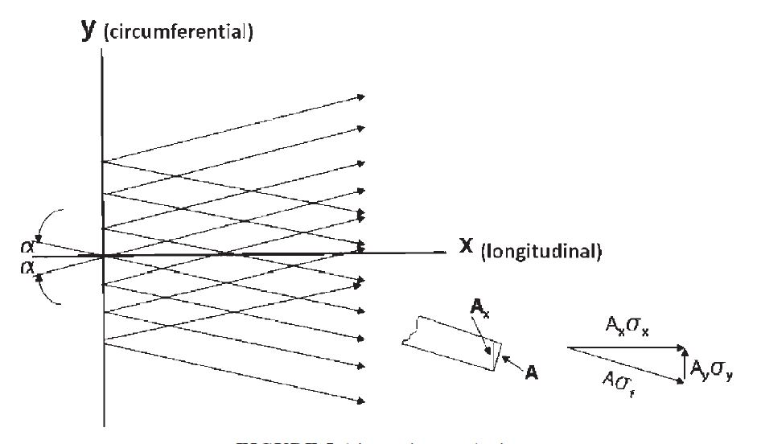
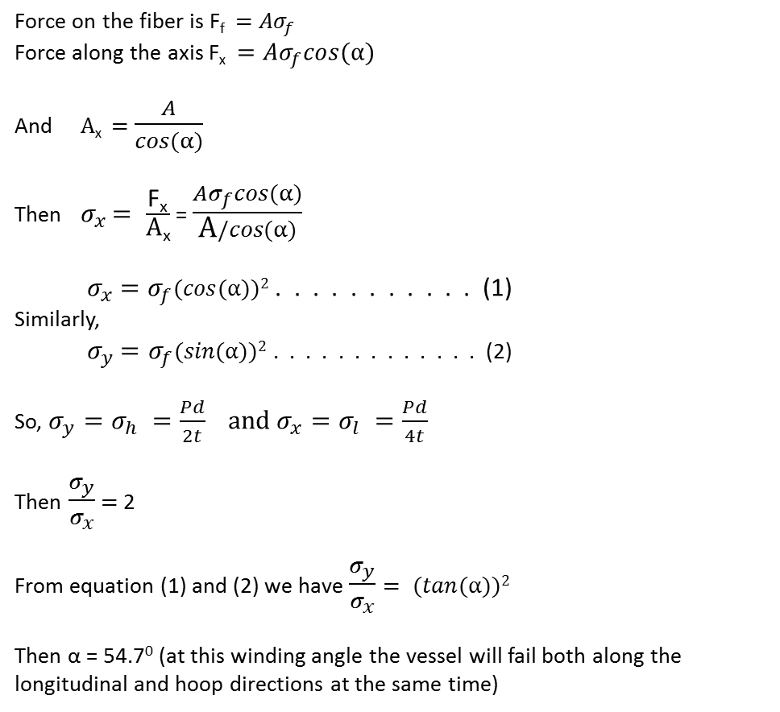
Netting Analysis
Force on the fiber is F_{f} $=$ ${Aσ}_{f}$
Force along the axis F_{x}$={Aσ}_{f}cos(α)$
And $\text{A}\text{x} =$ $\frac{A}{cos(α)}$
Then ${ σ}_{x }= \frac{\text{F}\text{x}}{\text{A}\text{x}}$ = $\frac{{Aσ}_{f}cos(α)}{\text{A}/cos(α)}$
${ σ}_{x} =σ_{f}(cos(α))2$ . . . . . . . . . . . (1)
Similarly,
${ σ}_{y} =σ_{f}(sin(α))2$ . . . . . . . . . . . . . (2)
So, $σ_{y}=σ_{h} =\frac{Pd}{2t} and σ_{x}=σ_{l} =\frac{Pd}{4t}$
Then $\frac{σ_{y}}{σ_{x}}$ $=$ 2
From equation (1) and (2) we have $\frac{σ_{y}}{σ_{x}}$ $= (tan(α))2$
Then α = 54.7⁰ (at this winding angle the vessel will fail both along the longitudinal and hoop directions at the same time)

Slide 46

For multiple layers and different angles (From equation (1) and (2))
We have, ${ σ}_{x}(t1+t2+t3 \text{. . . . } \text{.}+tn) =σ_{f1}t1(cos(α1))2$ $+σ_{f2}t2(cos(α2))2+σ_{f3}t3(cos(α3))2\text{. . . . .}+σ_{fn}tn(cos(αn))2$
Similarly, ${ σ}_{y}(t1+t2+t3 \text{. . . . .}+tn) =σ_{f1}t1(sin(α1))2 +σ_{f2}t2(sin⁡(α2))2+σ_{f3}t3(sin(α3))2\text{. . . . .}+σ_{fn}tn(sin(αn))2$
The above equations are valid for same and different materials for example carbon/epoxy (with fiber strength $σ_{f1},\text{layer} \text{thikness} t1 , winding angleα1$), the other layer can be made of glass/epoxy (with fiber strength $σ_{f2},\text{layer} \text{thikness} t2 , winding angleα2$) etc.
Number of helical layer $=$ $\frac{2tαf}{Vf}$ (where $Vf$ is fiber volume fraction)
Number of hoop layer $=$ $\frac{2t90f}{Vf}$

Slide 47
References:
“Principles of the Manufacturing of Composite Materials” Book by Suong V Hoa, DEStech Publications, Inc.

Slide 48
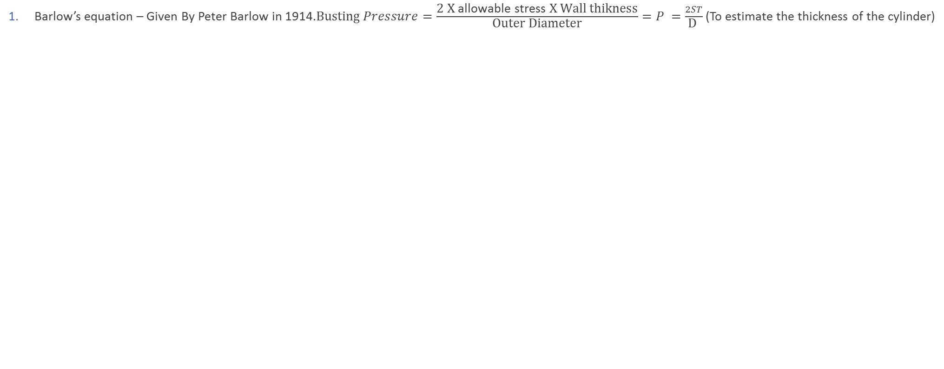
Design :
Barlow’s equation – Given By Peter Barlow in 1914.$\text{Busting} Pressure=\frac{\text{2 }\text{X} \text{allowable} \text{stress} \text{X} \text{Wall} \text{thikness}}{\text{Outer} \text{Diameter}}=P =\frac{2ST}{\text{D} }$ (To estimate the thickness of the cylinder)

Slide 49
Winding pattern
Filament winding is an expensive and automated method for positioning fibers in a precise pattern that adapts to the path of stress by allowing the efficient use of high strength fibers for enhanced structural efficiency.
It depends on four factors:
Mandrel
Fiber overwrapping and winding pattern
Fiber tension
Winding speed

Slide 50
1. mandrel
Mandrel serves as rotating surface on which the fibers are wound. These are removable and non removable type
For composite pressure vessels, an internal liner serves as a mandrel for winding and prevents leakage.
Geometrical parameters: When winding filament on mandrel surface, two types of trajectories are commonly used: geodesic and non- geodesic
Geodesic winding | Non- geodesic winding
Shortest part between 2 arbitrary points on the surface | Non geodesic are employed to increase design flexibility
Stable and non slip | Non stable and require frictional force to keep them from slipping
Used widely in symmetric and asymmetric as well | Used more on complex design
In plane, lateral force is zero | In plane, opposite case occurs that of geodesic

Slide 51
2. Fiber overwrapping and winding pattern
Wet and dry winding are the two types of winding methods.
Wet winding | Dry winding
The fibers are soaked in resin and wrapped around a rotating mandrel | The pre-impregnated fiber tows are wound on the mandrel
Lower material cost, shorter winding periods, provides fiber volume control | Costlier as compared to wet winding
Winding pattern based on winding angle
Hoop winding
Helical winding
Polar winding

Slide 52
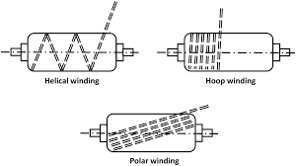
Winding angle: formed by the fiber path on the mandrel’s surface and rotational axis.
Hoop winding: angle is 90⁰ or slightly less than 90⁰ to allow the fiber winding next to the current circuit. It offers radial strength to the structure.
Helical winding: the angle lies in the range of 0⁰ to less than 90⁰ or between 5⁰ to 85^{0.}. It is often used to make composite tubes and pressure vessels.
Polar winding: fibers are wound from pole to pole, angle is not constant and depends on mandrel’s length.

Slide 53
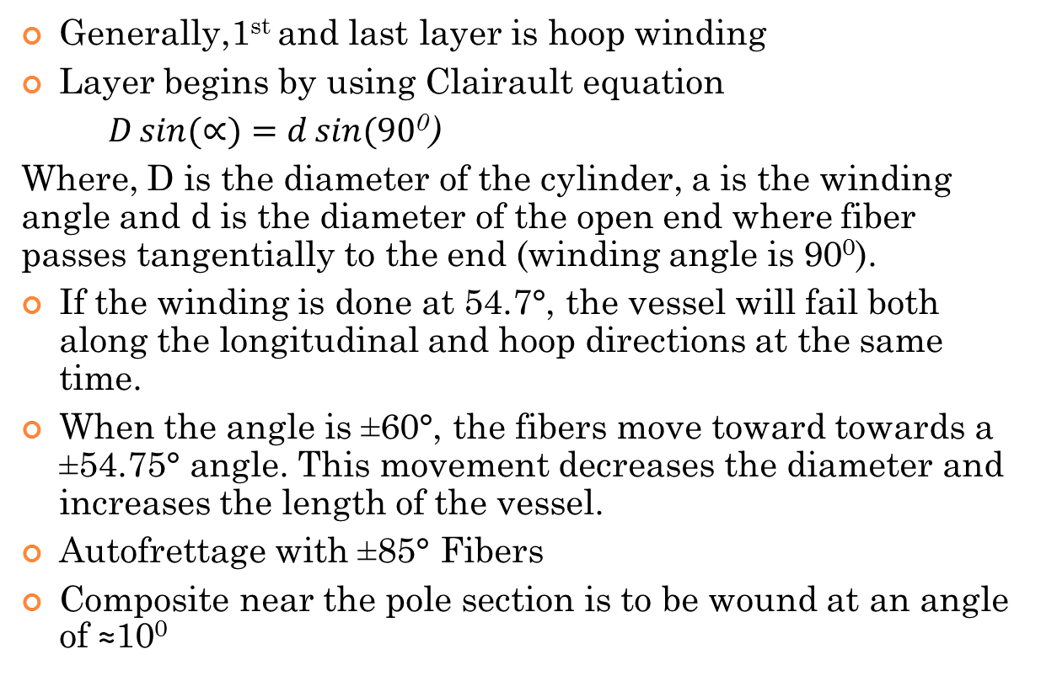
Generally,1st and last layer is hoop winding
Layer begins by using Clairault equation
$D\sin{(∝)}=d\sin{(90}$⁰)
Where, D is the diameter of the cylinder, a is the winding angle and d is the diameter of the open end where fiber passes tangentially to the end (winding angle is 90⁰).
If the winding is done at 54.7°, the vessel will fail both along the longitudinal and hoop directions at the same time.
When the angle is ±60°, the fibers move toward towards a ±54.75° angle. This movement decreases the diameter and increases the length of the vessel.
Autofrettage with ±85° Fibers
Composite near the pole section is to be wound at an angle of ≈10⁰

Slide 54
3. Fiber tension
It directly affects fiber volume fraction, void content and strength of the part.
Filament wound compound pressure vessels are designed to stack fibers in composite overwrapping at high stress levels for high performance application.
4. WINDING SPEED
Winding speed is an influencing parameter and is limited until the quality of impregnated tows (carbon fiber strand) must remain unaffected.
Winding speed influences the fiber tension. Fiber volume content and product quality.

Slide 55
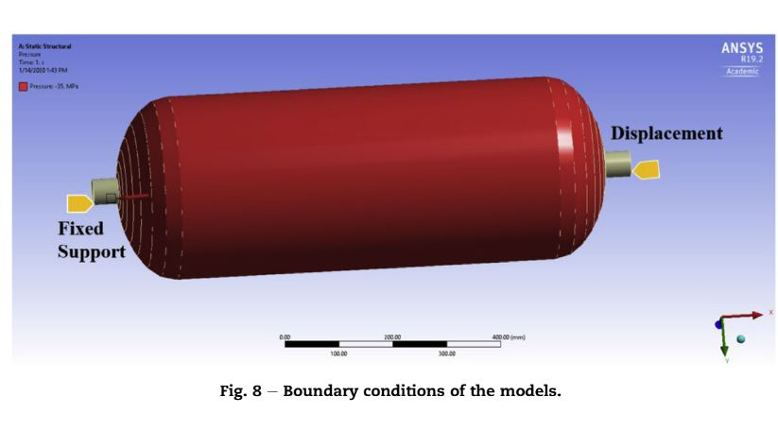
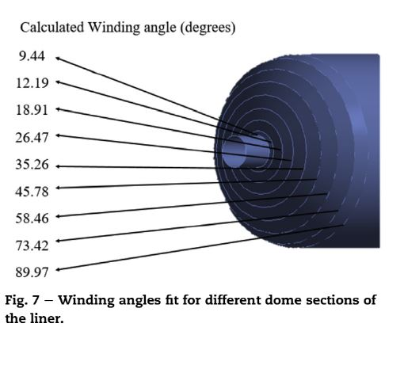
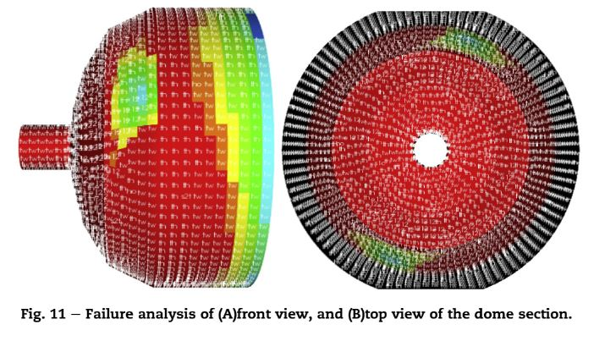
Simulation of type 3 composite cylinders

Slide 56
TESTING AS PER ISO 11119-2:2020[E]:
Hydraulic Proof Pressure Test
Hydraulic Volumetric Expansion Test
Liner Burst Test
Cylinder Burst Test
Ambient Cycle Test
Environmental Cycle Test
Flaw Test
Drop / Impact Test
High velocity Impact (Gunfire) Test
Fire Resistance (Bonfire) Test
Salt water Immersion Test (For Underwater application)
Torque Test (For Taper threads)
Environmentally Assisted Stress Rupture Test
Resin Shear Strength
Glass Transition Test

Slide 57
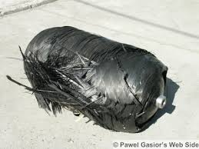
Pressure burst test:
Burst testing is conducted by introducing gas into the package at a controlled rate, maintaining the internal pressure for specific length of time, and inspecting for material failure which reveals weakest point.
It provides indication of the ability of a package to withstand internal pressure and the maximum internal pressure required to cause failure of the package seal.
For liner burst test:
One liner shall be tested hydraulically to destruction by pressurizing at a rate of not more than 5 bar/s. The test shall be carried out under ambient conditions.
Liner has a burst pressure greater
than or equal to 5% of Nominal burst
pressure of the finished composite
cylinder(≥ 53bar).

Slide 58
DROP / IMPACT TEST
For tubes over 150L water capacity:
• One or more empty tubes, with sealing device to protect threads and sealing surfaces, shall be impact tested at ambient temperature.
• One or two empty tubes shall be subjected to two impacts:
a) one to strike the tube on one end
b) one at an angle of 45° to strike the shoulder of the tube (mid arc length at the dome).
• The impact can be conducted by dropping a suitable weight or by a pendulum impact.
• The impactor shall be made from a steel bar and have a diameter of between 110 and 120 mm.
• Two levels of impact are permitted.
• Test one - an impactor with a potential energy of 1200J shall strike the
tube at the positions
• Test two - (if necessary) an impactor with a potential energy of 488J shall strike the tube at the positions
• After completion of the drop the tube(s) shall be subjected to cycle testing at 2/3 of the test pressure (P=350bar) for 12000 cycles.

Slide 59
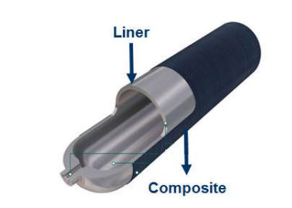
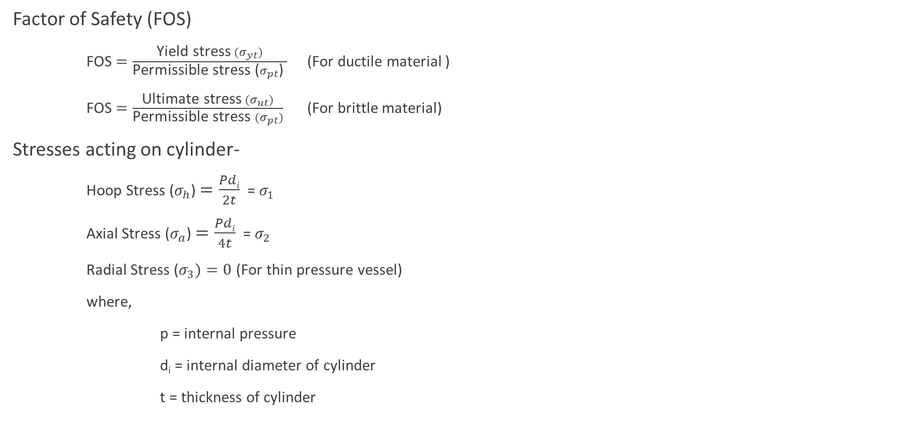
Theories of Failure
Factor of Safety (FOS)
FOS $=\frac{\text{Yield} \text{stress} (σ_{yt})}{\text{Permissible} \text{stress}\text{ (}σ_{pt}\text{)} }$ (For ductile material )
FOS $=\frac{\text{Ultimate} \text{stress} (σ_{ut})}{\text{Permissible} \text{stress} (σ_{pt})}$ (For brittle material)
Stresses acting on cylinder-
Hoop Stress ($σ_{h}$)$=\frac{Pdi}{2t}$ = $σ_{1}$
Axial Stress ($σ_{a}$)$=\frac{Pdi}{4t}$ = $σ_{2}$
Radial Stress ($σ_{3})=0$ (For thin pressure vessel)
where,
p = internal pressure
d_{i} = internal diameter of cylinder
t = thickness of cylinder
Fig. 1 Type-3 Cylinder

Slide 60
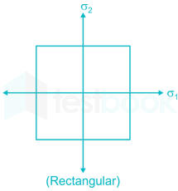
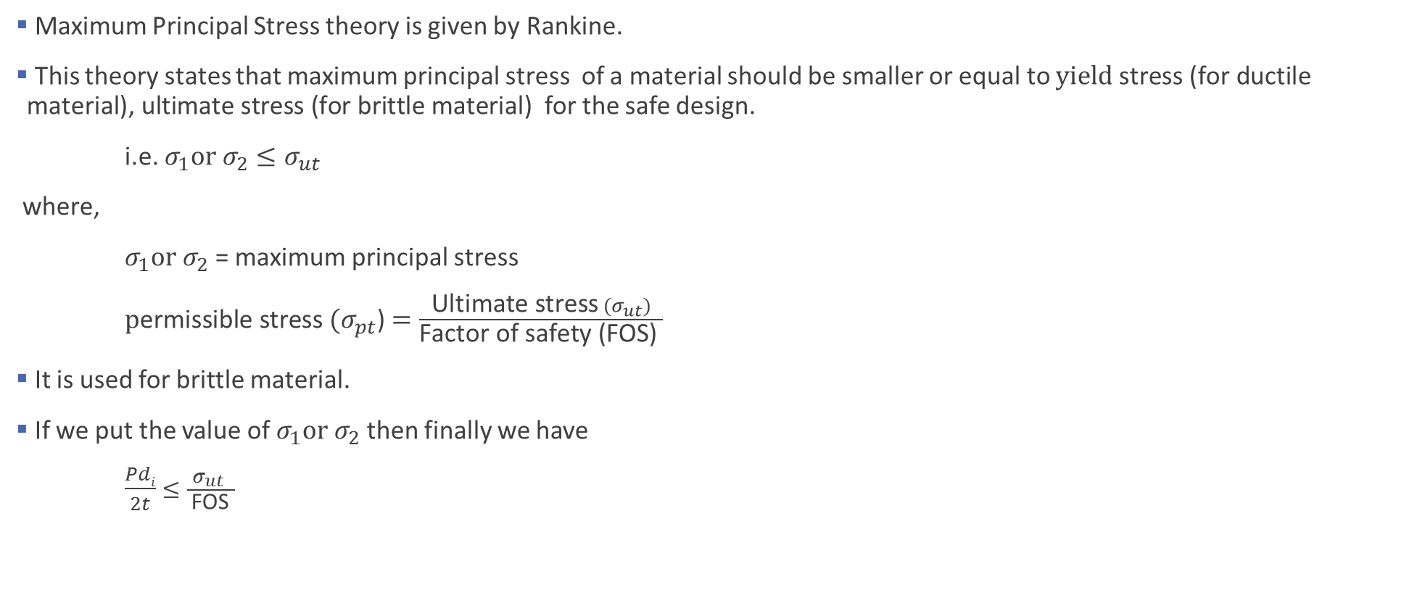



1. Maximum Principal Stress theory or Rankine’s theory
Maximum Principal Stress theory is given by Rankine.
This theory states that maximum principal stress of a material should be smaller or equal to $\text{yield} \text{stress}\text{ (}\text{for} \text{ductile} \text{material}\text{), }\text{ultimate} \text{stress}\text{ (}\text{for} \text{brittle} \text{material}\text{) }$ for the safe design.
i.e. $σ_{1}or{ σ}_{2}≤σ_{ut}$
where,
$σ_{1}or σ_{2}$= maximum principal stress
${ \text{p}\text{ermissible} \text{stress} (σ}_{pt}$) $=\frac{\text{Ultimate} \text{stress} (σ_{ut})}{\text{Factor} \text{of} \text{safety}\text{ (}\text{FOS}\text{)} }$
It is used for brittle material.
If we put the value of $σ_{1}{or σ}_{2}$ then finally we have
$\frac{Pdi}{2t}$ $≤\frac{σ_{ut} }{ \text{FOS} }$
$$σ_{ut}$$
$${−σ}_{ut}$$
$$σ_{ut}$$
$${−σ}_{ut}$$

Slide 61
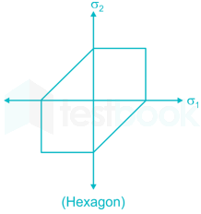




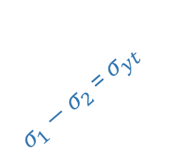

2. Maximum Shear Stress theory or Guest and Tresca’s theory
Maximum Shear Stress theory is given by Guest and Tresca.
This theory states that maximum shear stress of a material should be smaller or equal to yield shear stress for the safe design. It is used for ductile material.
i.e. $\text{τ}\text{max}≤\text{τ}\text{yt}$
Where,
$\text{τ}\text{max}$ $=$maximum Shear stress
$\text{τ}\text{max}=\frac{σ_{1}−σ_{3}}{2}$
Then $\frac{σ_{1}−σ_{3}}{2}≤\frac{σ_{yt}}{2}$
$\text{p}\text{ermissible} \text{stress} (σ_{pt}$) $=\frac{\text{Yield} \text{stress} (σ_{yt})}{\text{Factor} \text{of} \text{safety}\text{ (}\text{FOS}\text{)} }$
If we put the value of $σ_{1}$ and $σ_{3}$ , then finally we have,
$\frac{Pdi}{2t}$ $≤\frac{σ_{yt}}{ \text{FOS} }$
$$σ_{yt}$$
$σ_{2}−σ_{1}$ = $σ_{yt}$
$${−σ}_{yt}$$
$$σ_{yt}$$
$σ_{1}−σ_{2}$ = $σ_{yt}$
$${−σ}_{yt}$$

Slide 62
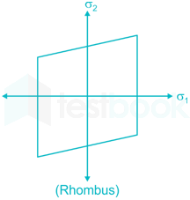

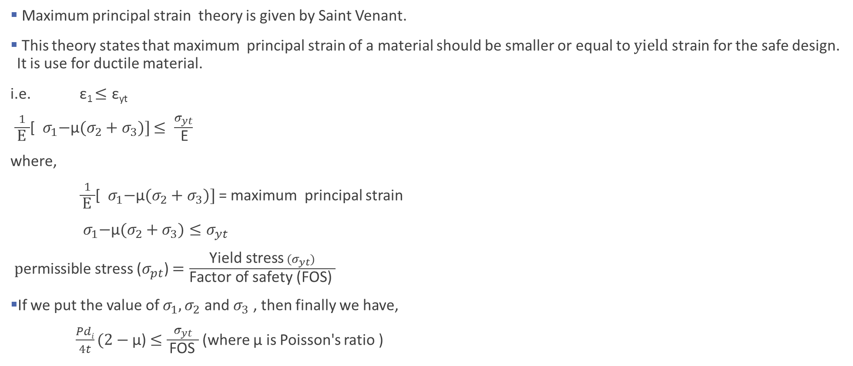



3. Maximum Principal Strain theory or Saint Venant’s theory
Maximum principal strain theory is given by Saint Venant.
This theory states that maximum principal strain of a material should be smaller or equal to $yield \text{strain}$ for the safe design. It is use for ductile material.
i.e. ε₁ $≤\text{ε}\text{y}\text{t}$
$\frac{1}{ \text{E} }$[${ σ}_{1}{−\text{µ}(σ}_{2}+σ_{3})]$ $≤ \frac{σ_{yt}}{ \text{E}}$
where,
$\frac{1}{ \text{E} }$[${ σ}_{1}{−\text{µ}(σ}_{2}+σ_{3})]$ = maximum principal strain
${ σ}_{1}{−\text{µ}(σ}_{2}+σ_{3})≤σ_{yt}$
$\text{p}\text{ermissible} \text{stress}$($σ_{pt}$) $=\frac{\text{Yield} \text{stress} (σ_{yt})}{\text{Factor} \text{of} \text{safety}\text{ (}\text{FOS}\text{)} }$
If we put the value of $σ_{1}{, σ}_{2}$ and $σ_{3}$ , then finally we have,
$\frac{Pdi}{4t}(2−\text{µ}\text{)}$ $≤\frac{σ_{yt}}{ \text{FOS} }$ (where $\text{µ}$ is Poisson's ratio )
$$σ_{yt}$$
$${−σ}_{yt}$$
$$σ_{yt}$$
$${−σ}_{yt}$$

Slide 63
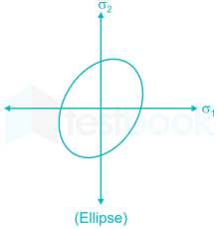

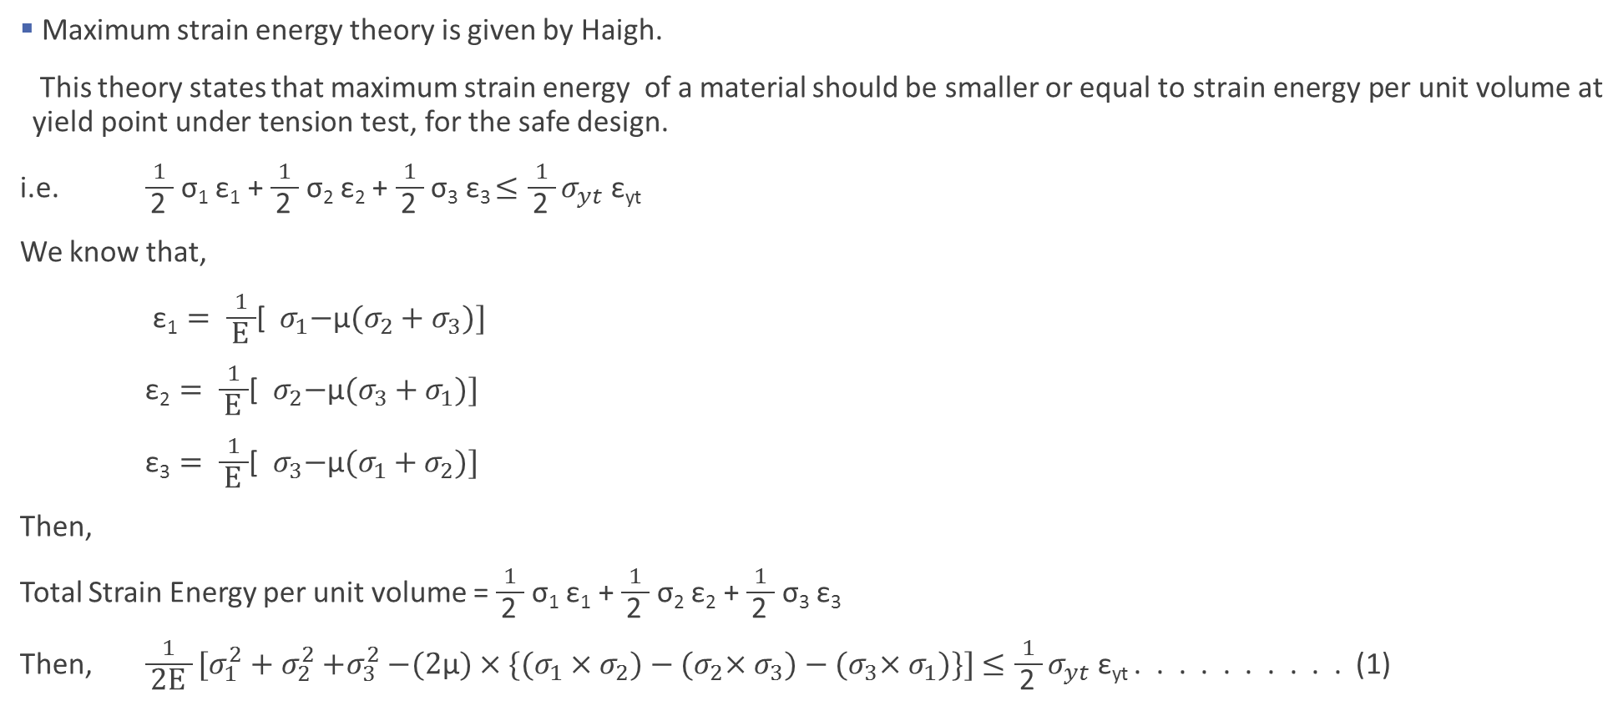



4. Maximum Strain Energy theory or Haigh’s theory
Maximum strain energy theory is given by Haigh.
This theory states that maximum strain energy of a material should be smaller or equal to$\text{strain} \text{energy} \text{per} \text{unit} \text{volume} \text{at} \text{yield} \text{point} \text{under} \text{tension} \text{test}\text{, }\text{for}$the safe design.
i.e. $\frac{1}{ \text{2} }$ σ₁ ε₁ + $\frac{1}{ \text{2} }$ σ₂ ε₂ + $\frac{1}{ \text{2} }$ σ₃ ε₃ $≤{\frac{1}{ \text{2} }σ}_{yt} \text{ε}\text{yt}$
We know that,
ε₁ $= \frac{1}{ \text{E} }$[${ σ}_{1}{−\text{µ}(σ}_{2}+σ_{3})]$
ε₂ $= \frac{1}{ \text{E} }$[${ σ}_{2}{−\text{µ}(σ}_{3}+σ_{1})]$
ε₃ $= \frac{1}{ \text{E} }$[${ σ}_{3}{−\text{µ}(σ}_{1}+σ_{2})]$
Then,
Total Strain Energy per unit volume = $\frac{1}{ \text{2} }$ σ₁ ε₁ + $\frac{1}{ \text{2} }$ σ₂ ε₂ + $\frac{1}{ \text{2} }$ σ₃ ε₃
Then, $\frac{1}{ \text{2}\text{E} }[σ_{1}^{2}+σ_{2}^{2}{+σ}_{3}^{2}−(2\text{µ})×\{(σ_{1}{×σ}_{2})−{(σ}_{2}{×σ}_{3})−{(σ}_{3}×σ_{1})\}]$ $≤{\frac{1}{ \text{2} }σ}_{yt} \text{ε}\text{yt}$ . . . . . . . . . . (1)
$$σ_{yt}$$
$${−σ}_{yt}$$
$$σ_{yt}$$
$${−σ}_{yt}$$

Slide 64
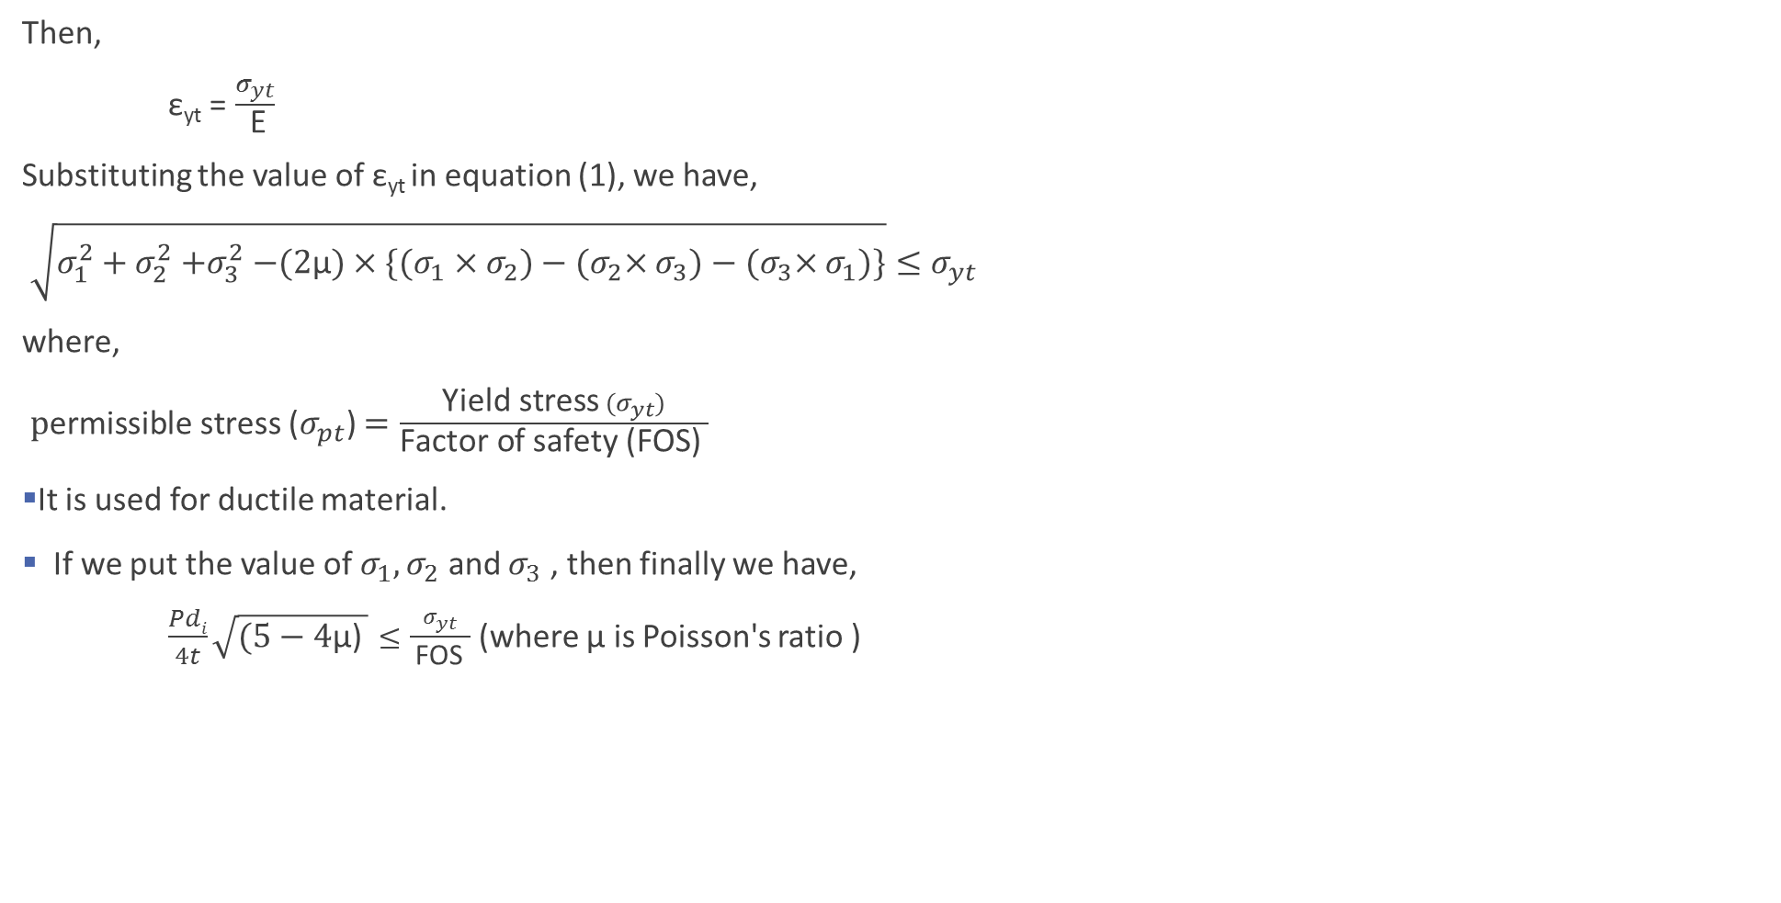
Then,
$\text{ε}\text{yt}$ = $\frac{σ_{yt}}{ \text{E}}$
Substituting the value of $\text{ε}\text{yt}$in equation (1), we have,
$\sqrt{σ_{1}^{2}+σ_{2}^{2}{+σ}_{3}^{2}−(2\text{µ})×\{(σ_{1}{×σ}_{2})−{(σ}_{2}{×σ}_{3})−{(σ}_{3}×σ_{1})\}}≤σ_{yt}$
where,
$\text{p}\text{ermissible} \text{stress}$($σ_{pt}$) $=\frac{\text{Yield} \text{stress} (σ_{yt})}{\text{Factor} \text{of} \text{safety}\text{ (}\text{FOS}\text{)} }$
It is used for ductile material.
If we put the value of $σ_{1}{, σ}_{2}$ and $σ_{3}$ , then finally we have,
$\frac{Pdi}{4t}\sqrt{(5−\text{4}\text{µ}\text{)} }≤\frac{σ_{yt}}{ \text{FOS} }$ (where $\text{µ}$ is Poisson's ratio )

Slide 65
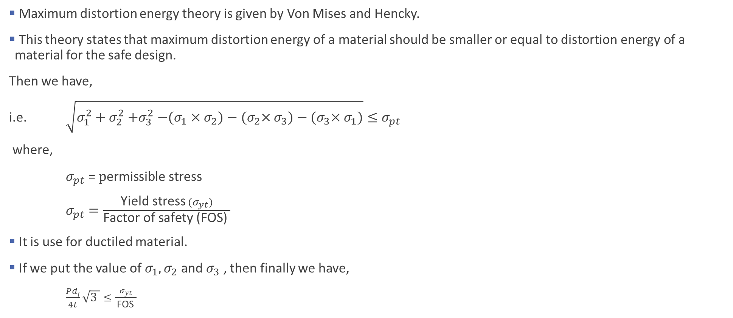
5. Maximum Distortion Energy theory or Von Mises and Hencky’s theory
Maximum distortion energy theory is given by Von Mises and Hencky.
This theory states that maximum distortion energy of a material should be smaller or equal to $\text{distortion} \text{energy} \text{of} \text{a} \text{material}$ for the safe design.
Then we have,
i.e. $\sqrt{σ_{1}^{2}+σ_{2}^{2}{+σ}_{3}^{2}−(σ_{1}{×σ}_{2})−{(σ}_{2}{×σ}_{3})−{(σ}_{3}×σ_{1})}≤σ_{pt}$
where,
$σ_{pt}$ = $\text{p}\text{ermissible} \text{stress}$
$σ_{pt}$ $=\frac{\text{Yield} \text{stress} (σ_{yt})}{\text{Factor} \text{of} \text{safety}\text{ (}\text{FOS}\text{)} }$
It is use for ductiled material.
If we put the value of $σ_{1}{, σ}_{2}$ and $σ_{3}$ , then finally we have,
$\frac{Pdi}{4t}\sqrt{3 }≤\frac{σ_{yt}}{ \text{FOS} }$
$$σ_{yt}$$
$${−σ}_{yt}$$
$$σ_{yt}$$
$${−σ}_{yt}$$

Slide 66
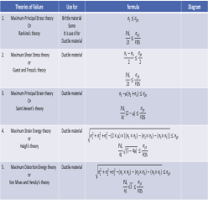

Summary
Theories of Failure | Use for | formula | Diagram
Maximum Principal Stress theory Or Rankine’s theory | Brittle material Some It is use d for Ductile material | $$σ_{1}≤σ_{pt}$$ $$\frac{Pdi}{2t}≤\frac{σ_{ut}}{ \text{FOS} }$$
Maximum Shear Stress theory or Guest and Tresca’s theory | Ductile material | $$\frac{σ_{1}−σ_{3}}{2}≤\frac{σ_{pt}}{2}$$ $$\frac{Pdi}{2t}≤\frac{σ_{yt}}{ \text{FOS} }$$
Maximum Principal Strain theory Or Saint Venant’s theory | Ductile material | $$σ_{1}{−\text{µ}(σ}_{2}+σ_{3})≤σ_{pt}$$ $$\frac{Pdi}{4t}(2−\text{µ})≤\frac{σ_{yt}}{ \text{FOS} }$$
Maximum Strain Energy theory or Haigh’s theory | Ductile material | $$\sqrt{σ_{1}^{2}+σ_{2}^{2}{+σ}_{3}^{2}−(2×\text{µ})×\{(σ_{1}{×σ}_{2})−{(σ}_{2}{×σ}_{3})−{(σ}_{3}×σ_{1})\}}≤σ_{pt}$$ $$\frac{Pdi}{4t}\sqrt{(5−\text{4}\text{µ}\text{)} }≤\frac{σ_{yt}}{ \text{FOS} }$$
Maximum Distortion Energy theory or Von Mises and Hencky’s theory | Ductile material | $$\sqrt{σ_{1}^{2}+σ_{2}^{2}{+σ}_{3}^{2}−(σ_{1}{×σ}_{2})−{(σ}_{2}{×σ}_{3})−{(σ}_{3}×σ_{1})}≤σ_{pt}$$ $$\frac{Pdi}{4t}\sqrt{3 }≤\frac{σ_{yt}}{ \text{FOS} }$$

Slide 67
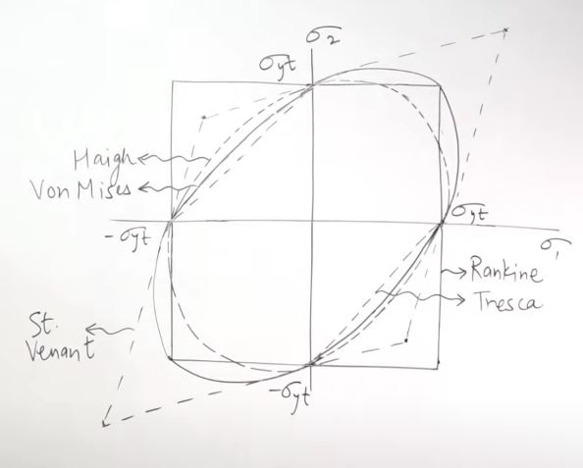
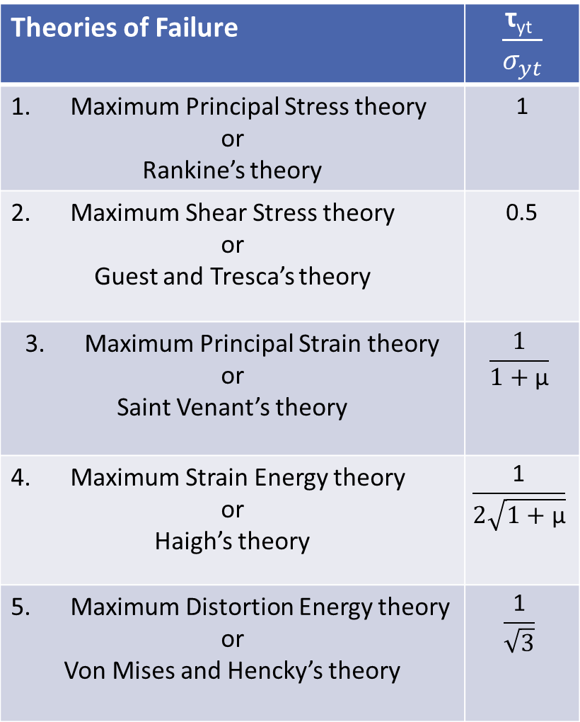
Theories of Failure | $$\frac{\text{τ}\text{yt} }{σ_{yt}}$$
Maximum Principal Stress theory or Rankine’s theory | 1
Maximum Shear Stress theory or Guest and Tresca’s theory | 0.5
Maximum Principal Strain theory or Saint Venant’s theory | $$\frac{1}{1+\text{µ}}$$
Maximum Strain Energy theory or Haigh’s theory | $$\frac{\text{1}}{2\sqrt{1+\text{µ}}}$$
Maximum Distortion Energy theory or Von Mises and Hencky’s theory | $$\frac{\text{1}}{\sqrt{3}}$$

Slide 68
References:
“ Strength of Materials” Book by S S Rattan, McGraw Hill Education (India) Private Limated; Second edition.
Machine design playlist of Exergic channel.

Slide 69
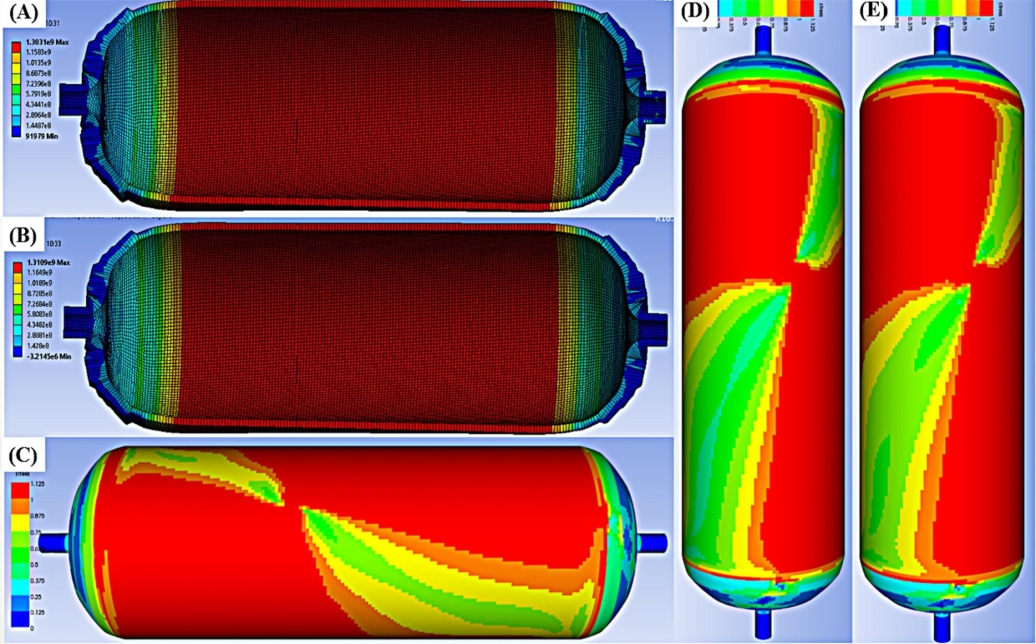
(A) Von Mises stress, (B) maximum principal stress, (C) Tsai-Hill failure, (D) Tsai-Wu failure, and (E) Hoffmann failure analysis.

Slide 70
Thank You

